Slide 1
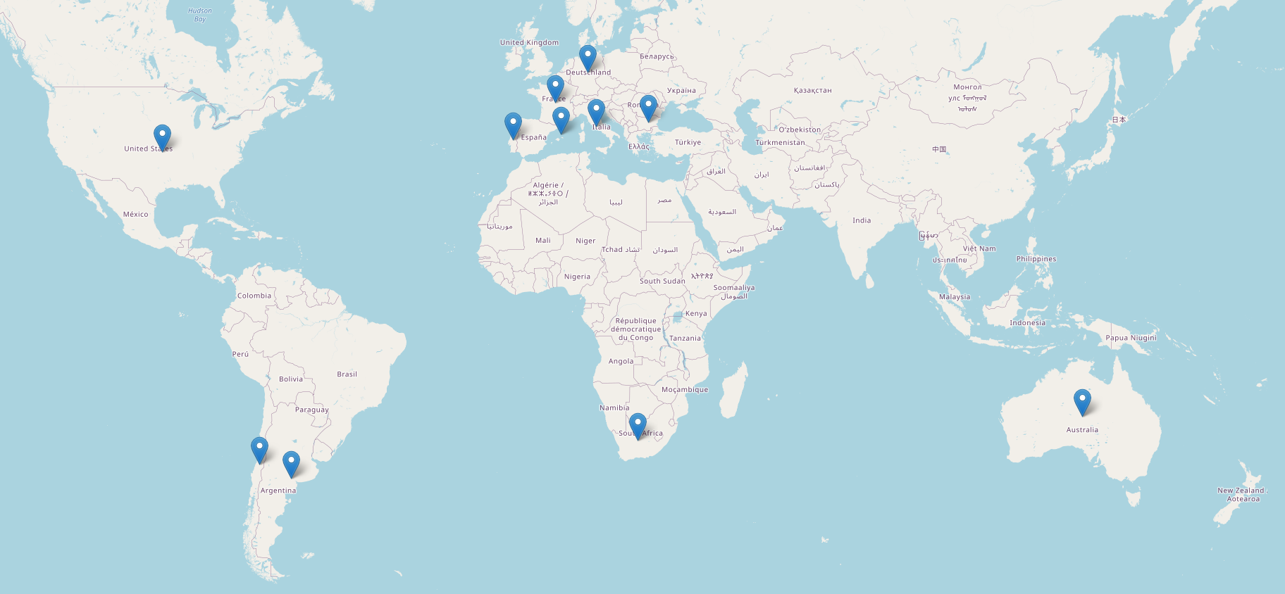
Wine NMR Multitask Prediction
Ross Kunz
8/31/2021

Slide 2
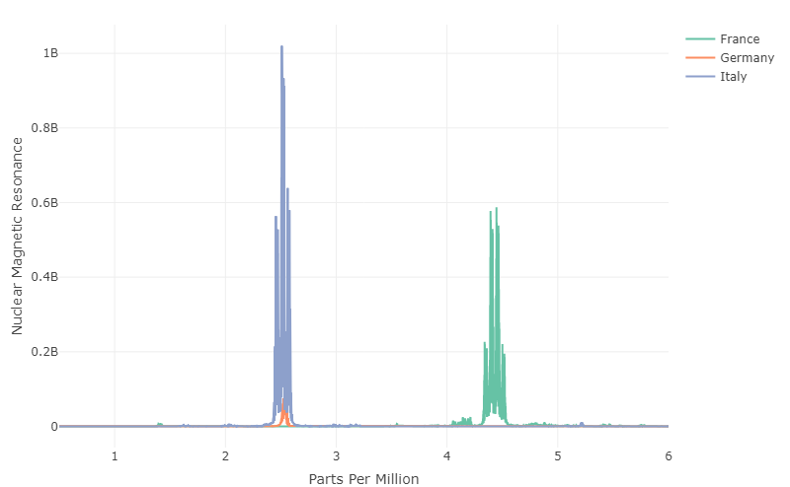
Data
Objective
Predict the chemical analyte signal for multiple attributes
Nuclear Magnetic Resonance (NMR) data for each sample
No environmental predictors
Dimensions
40 samples from globally locations
8712 NMR measurements
17 different responses
Larsen et al. "An exploratory chemometric study of 1H NMR spectra of table wines." Journal of Chemometrics: A Journal of the Chemometrics Society 20.5 (2006): 198-208

Slide 3
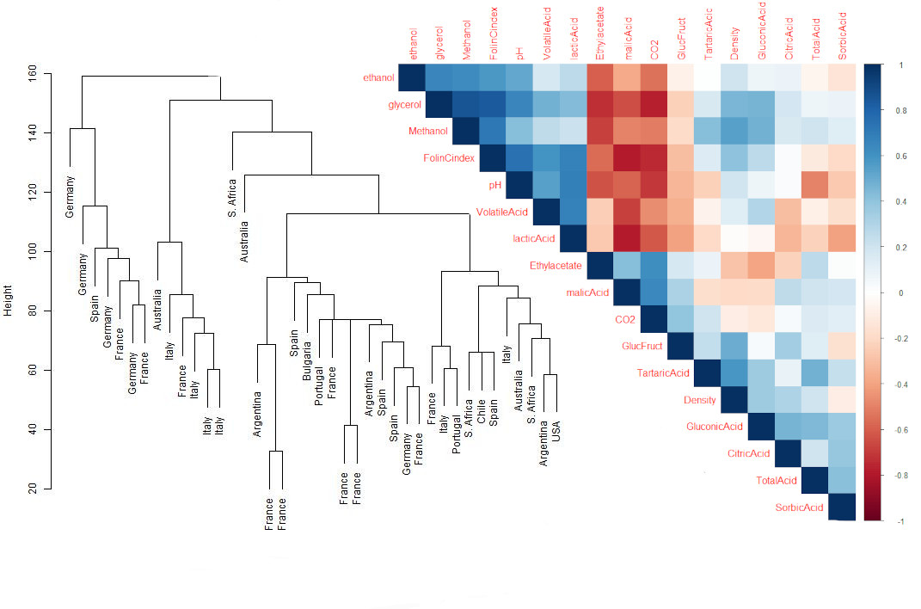
Exploration
There may exist relationships between samples
Far left: Europe
Middle: Mediterranean / Australia
Strong relationships along diagonal for most variables
Strong block of negative correlation values

Slide 4
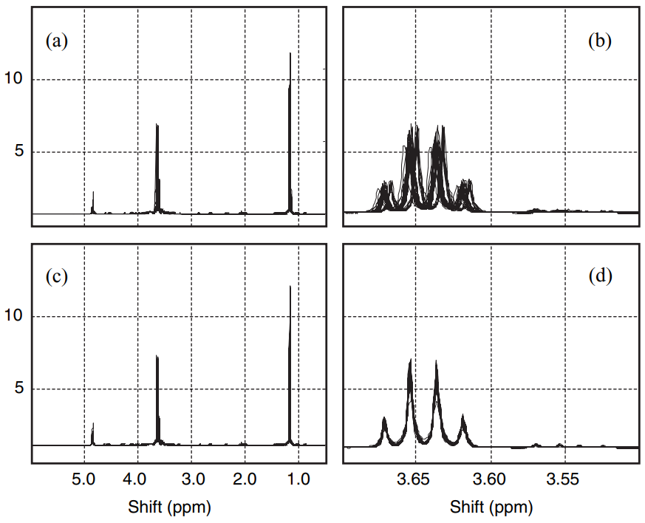
Data Problems
Extremely high-dimensional
Low sample space (40) by ~9k
Multicollinearity between NMR features
Autocorrelation of the NMR with respect to PPM
Misalignment of peaks
Multitask learning problem
Correlation exists between responses
Larsen et al. "An exploratory chemometric study of 1H NMR spectra of table wines." Journal of Chemometrics: A Journal of the Chemometrics Society 20.5 (2006): 198-208

Slide 5
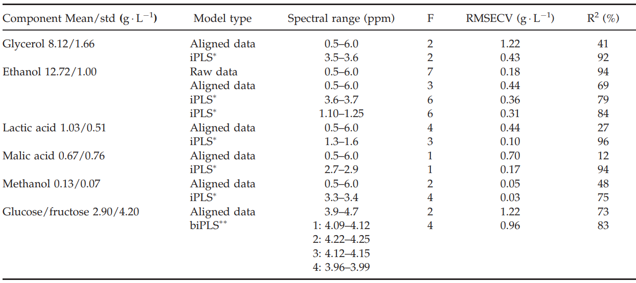
Previous Solution
Partial Least Squares (PLS)
Like Principal Component Regression
Use of X and Y in projection
Bread and butter of chemometrics
Iterative Partial Least Squares
Extension of PLS
Extensive search over all predictors for subset selection
Different number of factors (F) and predictors (spectral range)
Larsen et al. "An exploratory chemometric study of 1H NMR spectra of table wines." Journal of Chemometrics: A Journal of the Chemometrics Society 20.5 (2006): 198-208

Slide 6
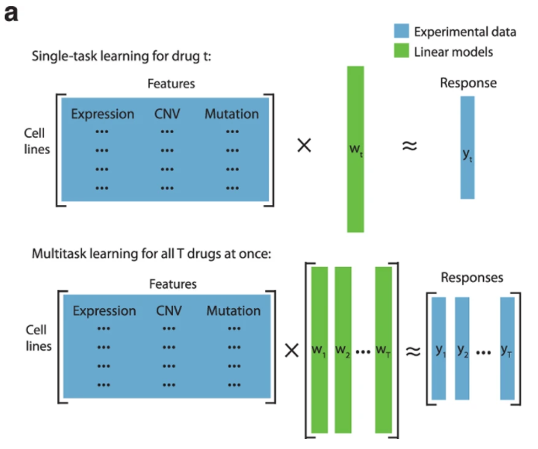
Proposed Solution
Penalized Least Squares
Multitask approach via sparse group lasso
Elastic-net
Multicollinearity
Reduction in the total number of predictors
Tuning the hyper-parameters via cross validation
Grouped variable selection across all responses
GLMNET
Optional:
Use of raw NMR
Perform Principal Component Regression (PCR)
Yuan, Han, et al. "Multitask learning improves prediction of cancer drug sensitivity." Scientific reports 6.1 (2016): 1-11.

Slide 7
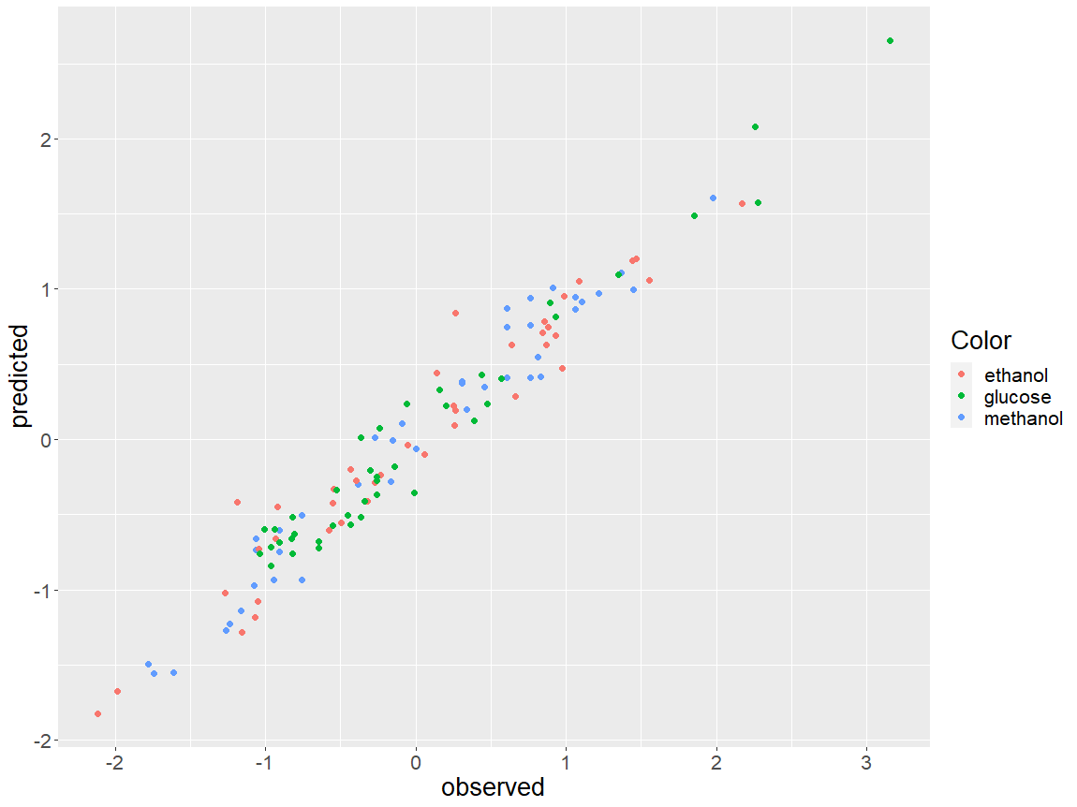
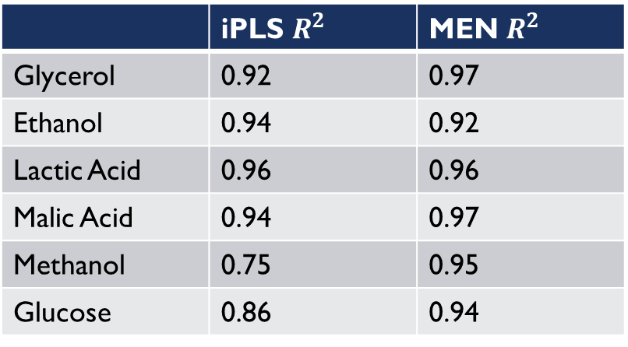
Performance
Multitask Elastic-Net
Average RMSECV of 0.63
Reduction in the predictor space by 93%
Same predictors among all responses
 | iPLS $R^{2}$ | MEN $R^{2}$
Glycerol | 0.92 | 0.97
Ethanol | 0.94 | 0.92
Lactic Acid | 0.96 | 0.96
Malic Acid | 0.94 | 0.97
Methanol | 0.75 | 0.95
Glucose | 0.86 | 0.94

Slide 8
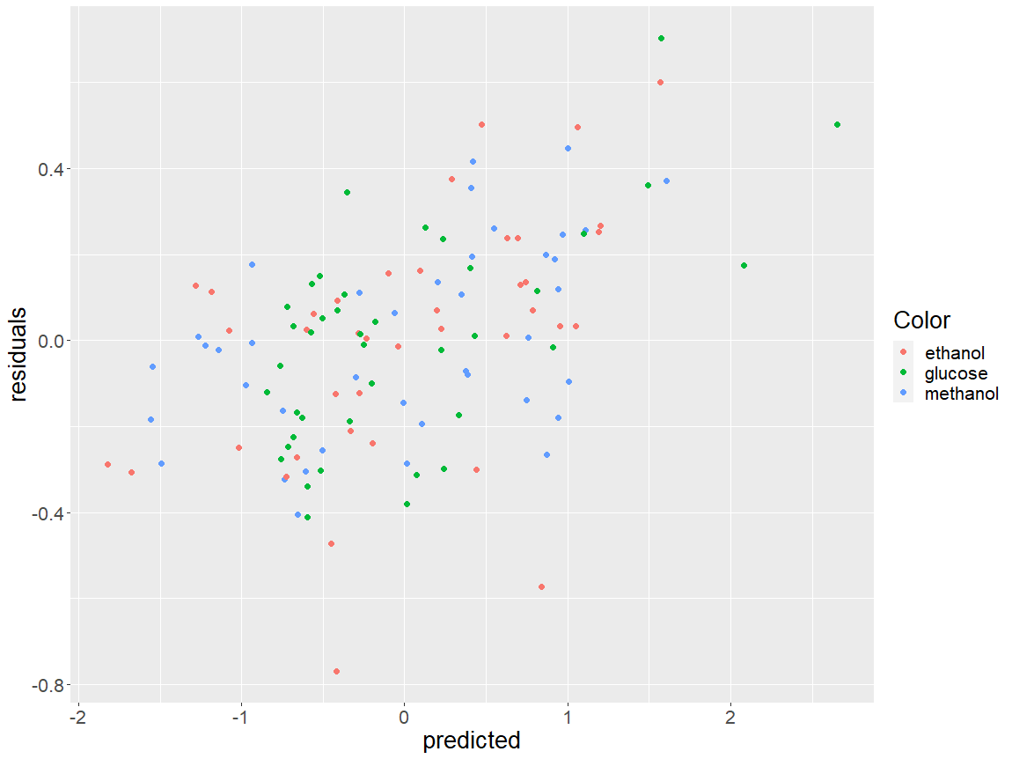
Diagnostics
Visible pattern at higher values
Potential non-linear effects
May be also be due to environmental factors / category
Similar trend per predictor
Only approximately 600 ppm values selected
Still too high?
No hold out validation set
Potential for overfitting

Slide 9
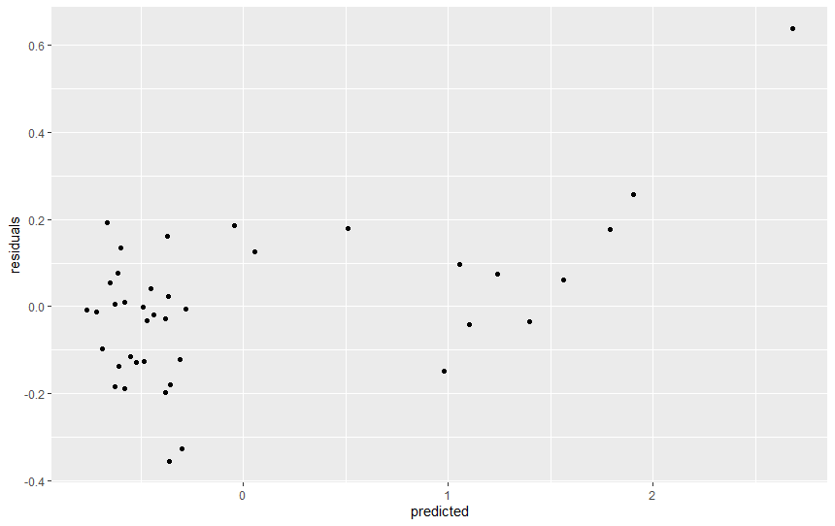
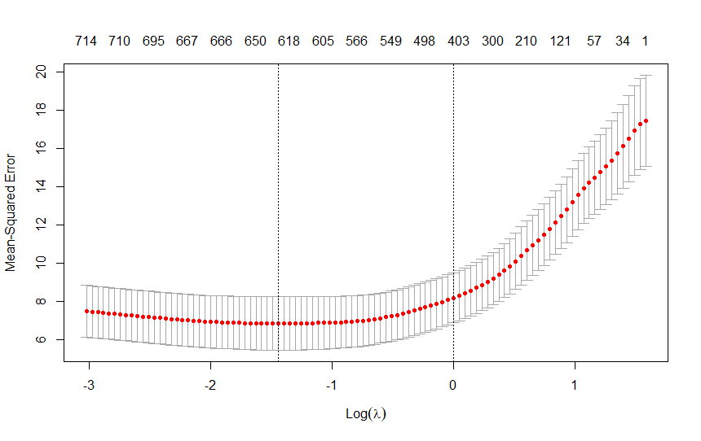
Potential follow-ons
There may exist non-linear effects based on residuals
Generalized Additive Models
Not accounting for environmental factors
Alignment of peaks using “Time Warping”
Different methods of feature selection
Non-convex methods SCAD
Adaptive lasso for consistent selection
Fused lasso for combining predictors

Slide 10
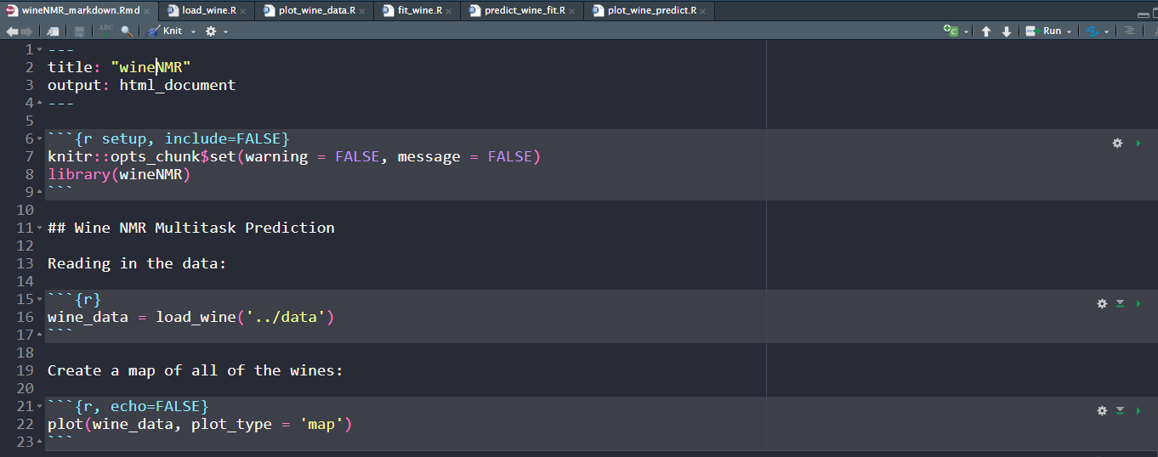
code
Created a small R package with the S3 class in mind for overloading methods
Load_wine: (R.matlab)
Plot.wine: (leaflet, plotly, corrplot, protoclust)
Fit_wine: (glmnet)
Predict.wine
Plot.wine_predict: (ggplot2)

Slide 11
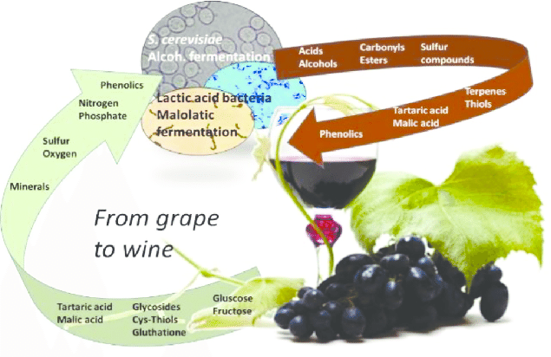
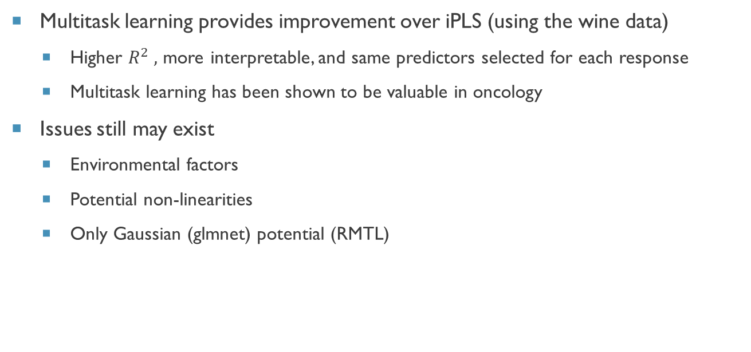
conclusions
Multitask learning provides improvement over iPLS (using the wine data)
Higher $R^{2} ,$ more interpretable, and same predictors selected for each response
Multitask learning has been shown to be valuable in oncology
Issues still may exist
Environmental factors
Potential non-linearities
Only Gaussian (glmnet) potential (RMTL)
Cosme, Fernanda, et al. "Grape and wine metabolites: Biotechnological approaches to improve wine quality." Grape and wine biotechnology (2016): 187-214.

Slide 12
Questions?
Thank you for your time and consideration of me joining the SomaLogic Group

